Slide 1
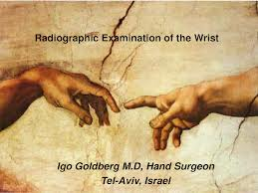
Fracture of the Distal radius
Dr. Alaa Abdulhussein Dawood
Assistant professor Orthopedic Surgery
Medical College ,Basrah University

Slide 3
objectives
To learn about these very common injuries.
To be able to reach a correct ,early diagnosis, and offer a good early management .
To be able to prevent important, and serious complications that may lead to crippling or permanent disability.

Slide 4
Colle’s fracture (Abraham Colles described in 1814)
@ Most common fracture in orthopedic practice.
@Usual victim is elderly women ( osteoporosis)
@It is extraarticular fracture of distal radius .
MECHANISM : Fall on the out stretched hand, fracture is at the corticocacellous junction .

Slide 5
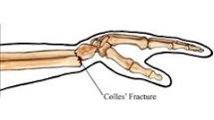
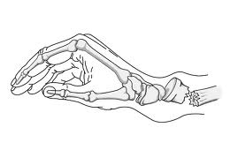
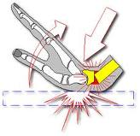
Transverse fracture 2.5 cm from distal radius. Distal fragment shifted &tilted dorsally ,also shifted radially.

Slide 6
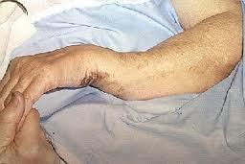
Clinical features :
Typical dinner fork deformity; broad wrist, local tenderness
painful wrist movement. look for other injury.
Examine for :neurovascular injury- median nerve injury (common)

Slide 7
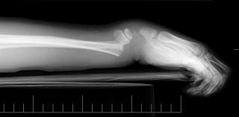
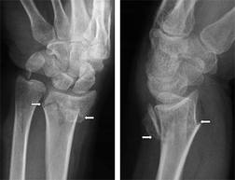
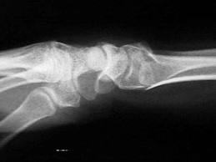
X-ray: PA ,Lateral &oplique veiw
Transverse fracture ; the distal fragment is shifted & tilted dorsally , also shifted radially.
Sometimes impacted or comminuted .
Often associated with fracture ulnar styloid .

Slide 8
treatment
Undisplaced fracture : plaster slab for 4-6 wks
Displaced fracture :
1)Reduction : under G.A , or sedation,disimpaction by traction on the hand, the wrist in palmar flexion, ulnar deviation , the forearm pronated, digital pressure on the distal fragment toward palmar side to correct the deformity.
Reduction is confirmed by x-ray.

Slide 9
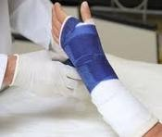

Slide 10
2)Immobilization :below elbow dorsal slab up to metacarpal neck with the wrist fixed in slight palmar flexion& ulnar devation.
3)After care :
> Elevation to watch for swelling(examine the fingers for swelling or cyanosis )
>complete pop done once swelling subsided .
>follow the patient weekly, by x-ray
>redispalacement is not uncommon ,if it occurs, repeat closed reduction.
>if alignment is satisfactory ,change the cast after 3 weeks &apply a new cast for further 3 wks.
>Encourage shoulder, elbow &finger exercises as early as possible.
4) Surgery : by internal fixation or external fixation in unstable,impacted or comminuted fractures .

Slide 11
Complications :
Early :1)circulatory embarrassment due to tight plaster.
2)Nerve injury: median nerve compression, carpal tunnel syndrome (rare).
3)Reflex sympathetic dystrophy(sudek atrophy)
Late :
1)Malunion : common
2)Delayed union or nonunion of ulnar styloid
3)Joint stiffness : of wrist & shoulder is common .
4)Tendon rupture : of extensor pollicis longus tendon .

Slide 12
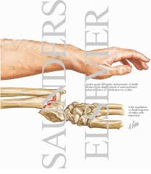
Smith’s fracture (Reversed Colles ) described a similar fracture about 20 years later
Uncommon , the distal fragment is displaced anteriorly ,
Cause : Fall on the dorsum of the hand
>Clinical features :
Typical deformity : Garden spade deformity

Slide 14
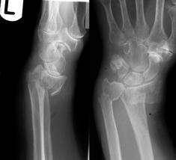
X-ray: PA ,Lateral& oplique
(PA) veiw:Transverse fracture of the distal radius
Lateral view : the distal fragment is displaced
&tilted volarly .

Slide 15
Treatment :
Displaced fractures (stable) :
!)Reduction :Under G.A ,sedation ,or L.A
traction , supination &extension of the wrist.
2)immobilzation : above elbow POP ,forearm supinated & wrist dorsiflexed for 6 weeks .
Displaced (unstable) :
1)closed reduction with percutaneous pinning
2) open reduction &fixation by a plate &screws

Slide 16
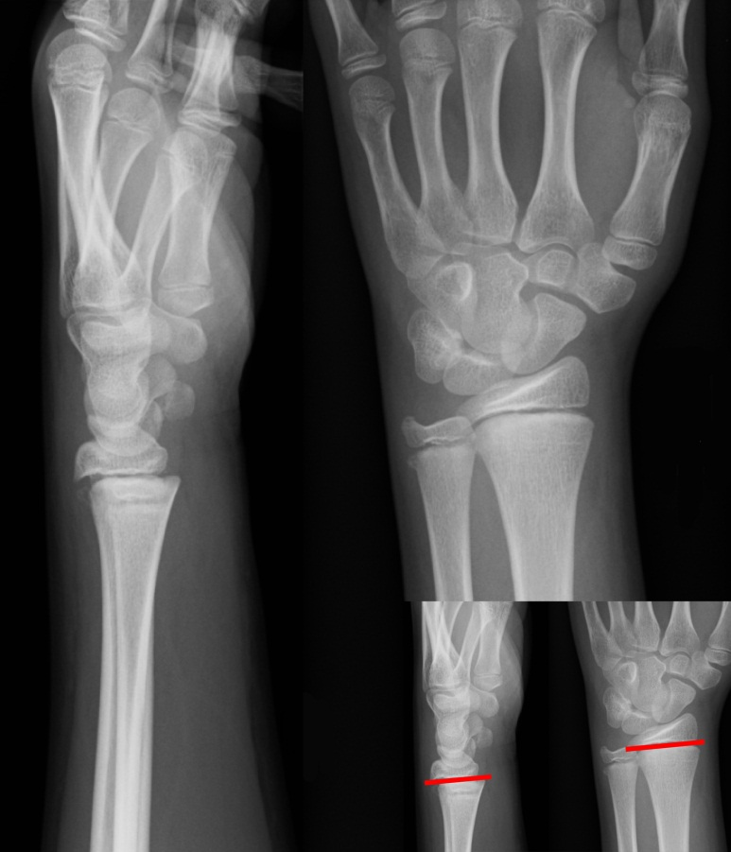
Fracture of the distal radius in children
Fall o the outstretched hand with the wrist in extension ,the distal fragment is displaced dorsally (Juvenile colle’s)
Sometimes the wrist is in flexion and the distal fragement is displaced anteriorly
The fracture is through the distal radial physis or in the metaphysis of one or both bones. Metaphyseal fracture are often incomplete or green stick .

Slide 17
Clinical features : pain, swelling of the wrist ,sometimes there is typical dinner fork deformity .
X-ray :accurate diagnosis is made on the x-ray appearance :
1)Physeal fractures: according to salter –harris classification
usually type 1or 2. Type 5 is unusual .

Slide 18
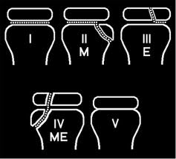
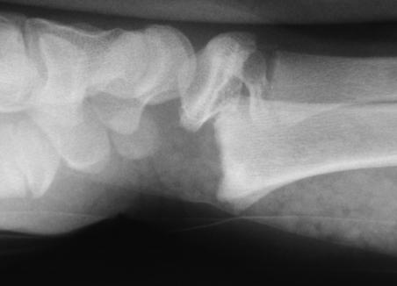

Slide 19
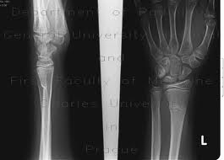
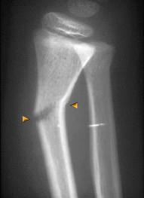
Metaphyseal fractures:
Appear as buckling of the cortex
Or as angulated greenstick fracture
Or as complete # with displacement

Slide 20
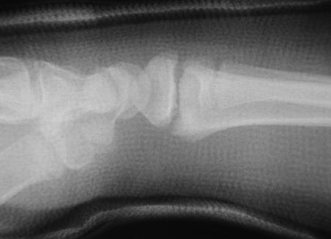
Treatment
Physeal fractures : reduction under G.A , or sedation ,immobilized in above elbow cast , with elbow in 90 D flexion, wrist slightly flexed &ulnar deviated.
Cast retained for 4 weeks.
* Buckle fracture:
2 Weeks in p.o.p , then 2 weeks of restricted activity .

Slide 21
Greenstick fractures:
closed reduction (easy ).
Children <10 years up to 30D angulation
Children>10 years up to 15 D angulation is
Accepted .
Above elbow p.o.p , for 2 weeks, then re x-ray
if redisplacement , repeat manipulation .
Cast removed after 6 weeks.
Complete fractures :
Difficult to reduce especially if the ulna is intact,
Closed reduction done as colles # , full length cast applied with wrist neutral & forearm supinated .reduction is checked by x-ray , which is repeated after 2 weeks , cast retained for 6 weeks .If # slips, then do closed reduction &percutaneous K wire fixation

Slide 22
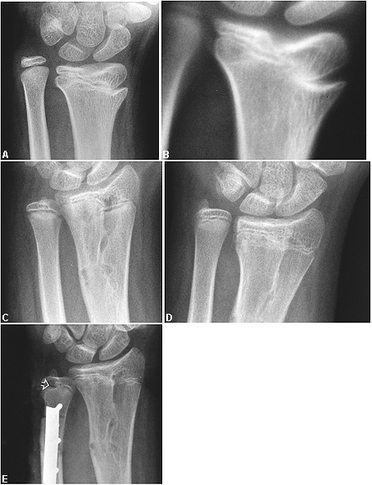
Complications :
Early : forearm swelling threatened compartmental syndrome .
Late :
1)Malunion :uncommon in children<10years because of remodelling power.
2) Radio-ulnar discrepancy :(physeal fracture , especially type 5) premature fusion of radial epiphysis ,leads to subluxation of distal radio ulnar joint.

Slide 23
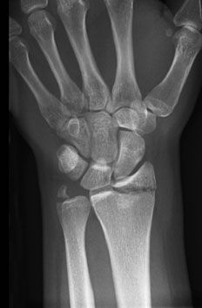
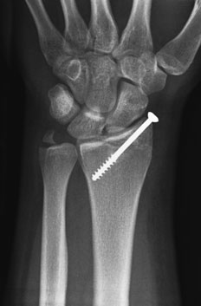
Radio-carpal fractures:
1)Fracture radial styloid (chauffer fracture ) :
forced radial deviation of the wrist after a fall , or when starting handle kick-back .
X-ray : transverse fracture line ,
TRT : closed reduction , wrist held in ulnar deviation by plaster slab , if failed , the fragment is fixed by percutaneous k-wire or screw .

Slide 24
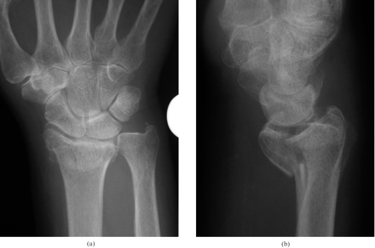
2)Fracture- subluxation(Barton fracture)
Types: Volar & Dorsal Barton .
Volar Barton (anterior marginal fracture) :
oblique fracture through the wrist joint, the distal fragment from anterior articular surface , displaced anteriorly carrying the carpus with it .

Slide 25
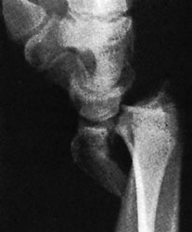
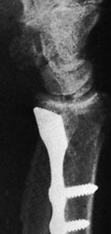
TRT : unstable fracture , usually redisplace after closed reduction ,so open reduction& internal fixation by small ant. Plate is recommended

Slide 26
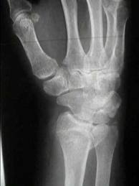
Dorsal Barton(posterior marginal fracture)
Oblique fracture through distal radius , the fracture line pass through the wrist joint ,
Distal fragment from dorsal articular lip , displaced upward &backward carrying the carpus with it.

Slide 27
TRT : 1)try closed reduction& cast for 6 weeks ,
2)IF failed;do closed reduction & percutaneous pinning , or open reduction and internal fixation by plate & screws .

Slide 28
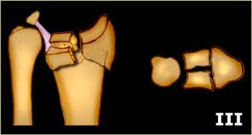
3)Comminuted intra articular fractures (young adults)
.High energy injury, poor outcome will result unless joint congruity, fracture alignment & length are restored , and movement started early .

Slide 29
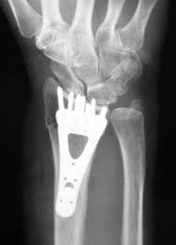
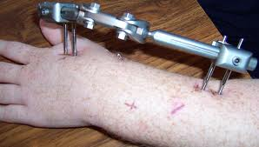
TRT : Reduction seldom possible , fracture is unstable & it is difficult to hold the reduction
Try closed reduction &above elbow cast ,take serial x-ray for follow-up.
If failure : ORIF , or by External fixation(ligamentotaxis)+bone graft

Slide 30
Complications of radiocarpal fractures
Associated injuries to the carpus
Redisplacement
Carpal instability
Secondary osteoarthritis

Slide 31
Questions
What are the steps in the diagnosis of trauma to wrist due to fall on the outstretched hand.
What are the dangerous complications you want to avoid in patients sustaining these injuries?
How to avoid the above complications?

Slide 32
Thank you

